Slide 1
Alzheimer's Disease Detection Using MRI
GROUP 19
Notes:
Hi everyone, we are team 19.
Our topic is Alzheimer's Disease Detection from MRI. Before dive into our presentation, I would like to share a true story with you.
This MRI image is for a 77 years old female, Linda. Linda was once a loving mother, grandmother, and wife. She enjoyed spending time with her family and creating memories.
As years passed, Linda began to lose memory and have difficulty recognizing her loved ones. She took MRI years ago but the doctor concluded it was a normal age-related brain shrinkage with no treatment needed. However, as her condition getting worse, the diagnosis finally came: Alzheimer's disease.

Slide 2
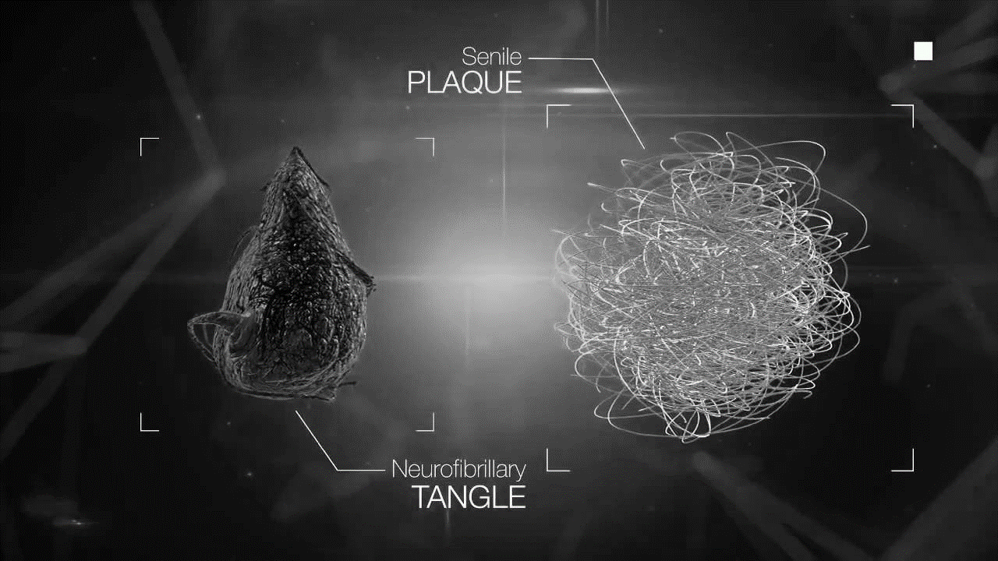
Introduction of Alzheimer’s Disease
Alzheimer’s disease (AD)
A progressive neurodegenerative disorder resulting in memory loss, cognitive impairment, behavioural changes, and eventually death
Pathophysiology:
Beta Protein Plaques
Tau Protein Tangles
Notes:
Alzheimer’s disease is a progressive neurological disorder leads to memory loss, cognitive impairment, behavioral change, and eventually death.
The cause of AD is Beta protein plaques and Tau protein tangles that deactivate cells and leading to death.

Slide 3
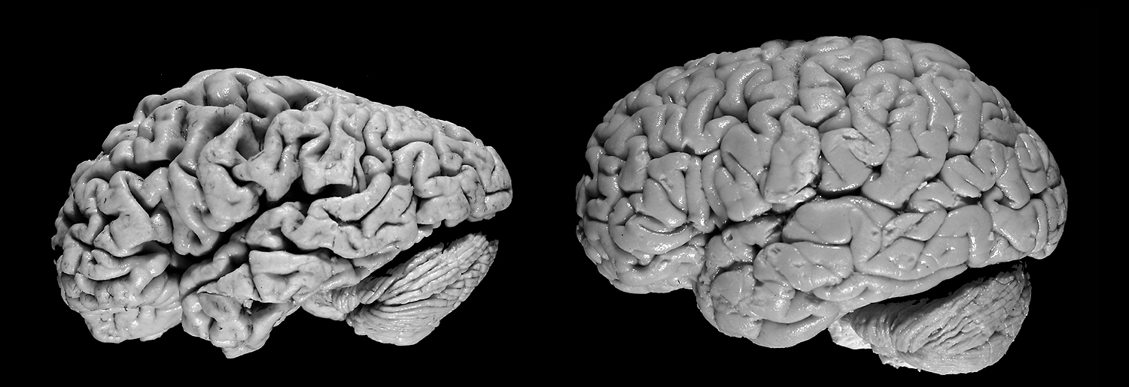
Difference Between Healthy Brain and Altheimer's Brain
Alzheimer's Brain
Healthy Brain
Notes:
It is obvious to see from the picture that the shrinkage make the AD brain much smaller than the healthy one.

Slide 4
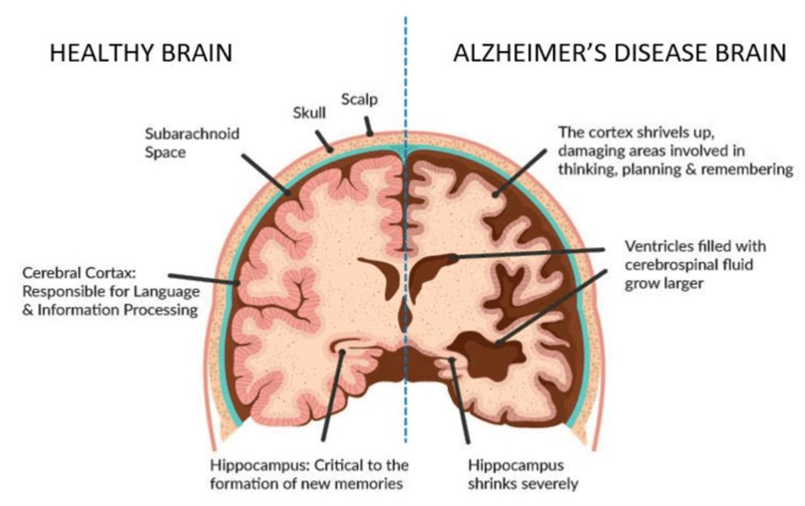
Healthy Brain vs. Alzheimer's Brain
Notes:
Here is another image to show the shrinkage in specific areas.

Slide 5
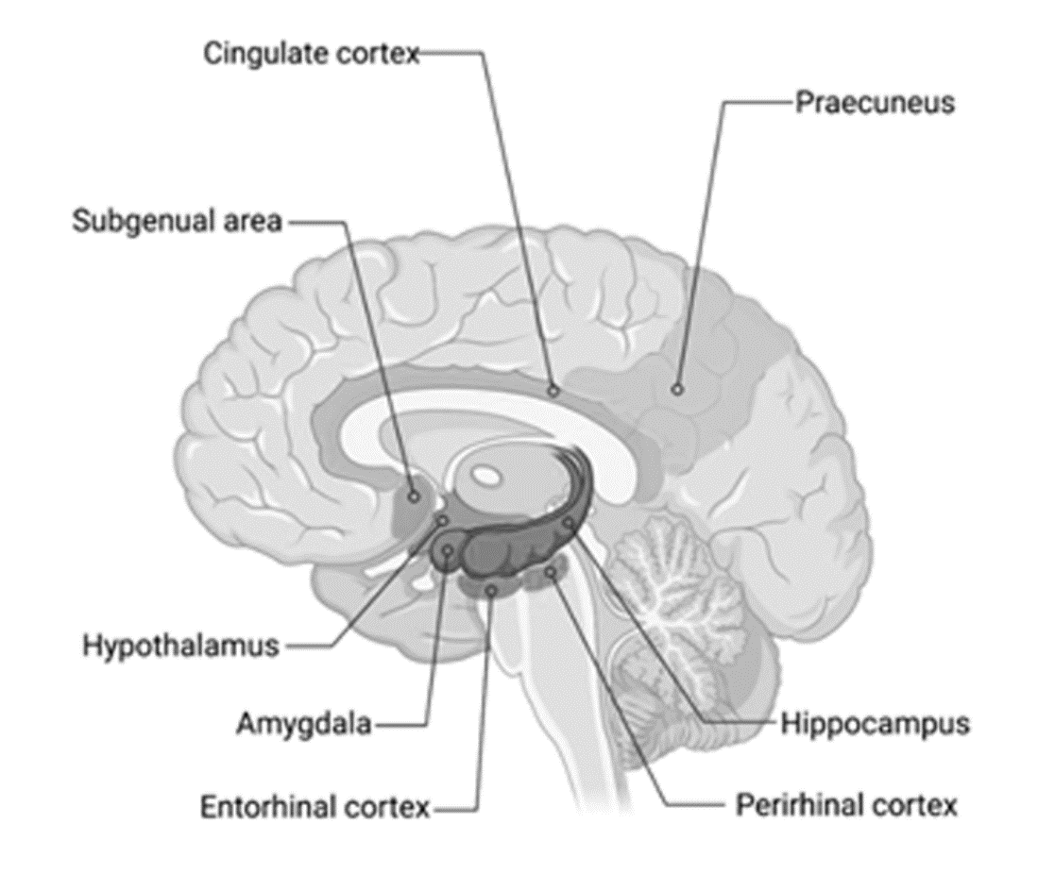
Structural MRI in the Diagnosis of AD
Structural MRI can detect cortical thickness reduction in specific brain areas
MRI is safe:
No ionizing radiation – does not cause cancer
Earliest changes identifiable using MRI
Medial temporal lobe structures

Slide 6
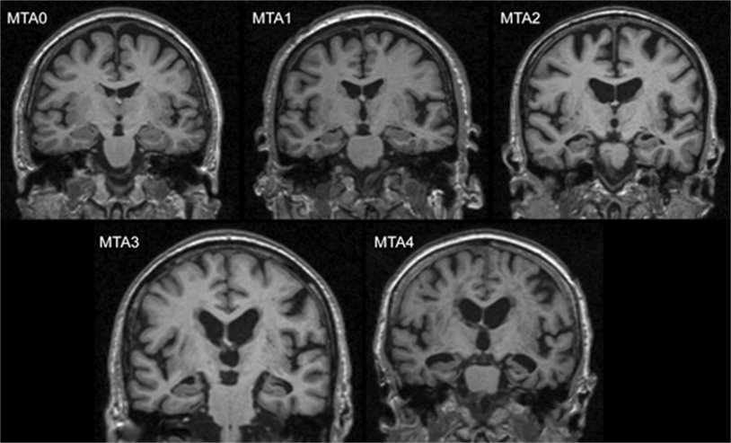
Rating Scales Used by Radiologists in Clinical Practice
Visual rating scales for assessing atrophy severity
Scheltens scale for Medial Temporal Atrophy (MTA)
Koedam scale for Posterior Atrophy
Pasquier scale for Frontal Atrophy
Sacle | Width of Choraoid Fissure | Width of Temporal Horn | Hippocampal Thickness
0 | N | N | N
1 | + | N | N
2 | ++ | + | ─
3 | +++ | ++ | ─ ─
4 | +++ | +++ | ─ ─ ─
Ventricle Enlargement
<75 years: MTA ≥2 is abnormal
≥75 years: MTA ≥3 is abnormal
Notes:
Some rating scales are used by radiologists to assess the severity of atrophy. We are taking MTA as example.
MTA measures the shrinkage of Medial Temporal Lobe. There are 4 stages of severity and as shown in red circles. MTA 0 means no atrophy. MTA 4 means severe hippocampus volumn loss and ventricle enlarged.

Slide 7
Accuracy of MRI in the Diagnosis of AD in Clinical Practice
Sensitivity (true positive): 62% - 92%
Specificity (true negative): 44% - 96%
Notes:
The accuracy by radiologists in clinical practice is usually reported in terms of sensitivity and specificity. One refers to the true positive and the other refers to the true negative.
The accuracy is depending on the scale used, ranging from 62% to 92% sensitivity and 44% to 96% specificity. That is to say, the variance of accuracy is pretty high.

Slide 8
Another Story?
Notes:
Now, back to our story at the very beginning. If the doctors were able to accurately detect the shrinkage of Linda’s brain, would there be another story? The answer is Yes. She might be able to receive early treatment, potentially delaying the disease or, at least, slowing the progression. Linda could have enjoyed more years of quality life, creating new memories and cherishing the old ones.

Slide 9
Quick Facts
152 Million
Top 10
seniors with AD
cause of death
5-7 Years
$1.3 Trillion
to educate radiologists
care cost
Hundreds of $
to train radiologists
Notes:
Here are some quick facts about AD. With an aging population, it’s predicted to have 152 million of AD patience worldwide by 2050. 159 billions US dollars for AD care cost in 2010. 5-7 years of education and hundreds of dollars to train a radiologist. To make it worse, AD is the top 10 disease that cause death but have no effective treatment. All the facts make early detection of AD and tracking its changes important.

Slide 10
Project Value Proposition
Machine learning Algorithm that enhances AD diagnosis with MRI
Increase accuracy in AD diagnosis
Distinguish between normal brain shrinkage and AD atrophy
Notes:
Therefore, our value proposition is to develop and optimize an AI technology that enhance AD diagnosis with MRI, increasing accuracy in image interpretation, and distinguishing between normal age-related brain shrinkage and AD atrophy.
Next, I’ll pass Jesse for the image preprocessing and augmentation parts.

Slide 11
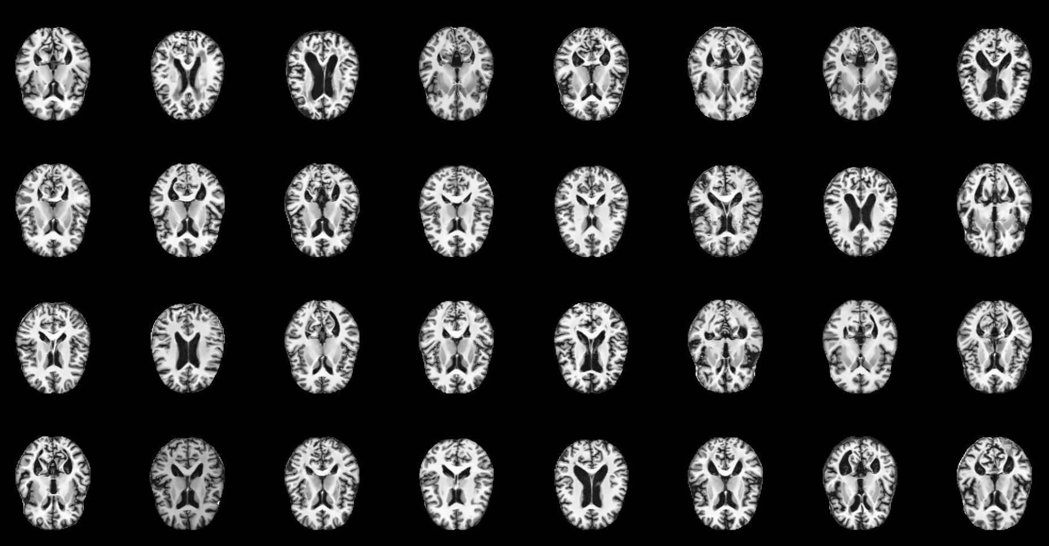
Dataset
Notes:
Thanks, Jisoo. Now, let’s get to the dataset. The dataset we have contains MRI images of patients’ brains. Each image represents one patient.

Slide 12
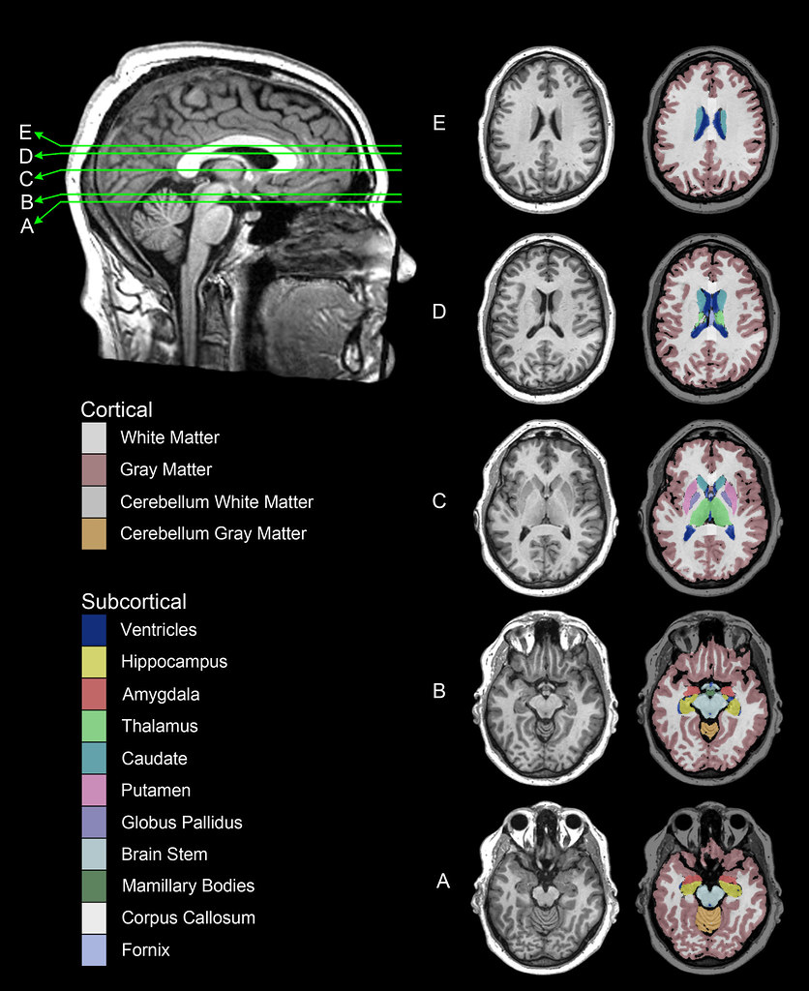
Dataset
Notes:
The MRI images may look very different because they are from different slices of the head. Some were cut above the midbrain, and some were cut below.

Slide 13
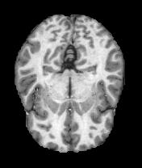

Preprocessing
Contrast enhancement
Denoising
Intensity normalization
Binarization
Notes:
To effectively detect Alzheimer's disease, image preprocessing is crucial. As Alzheimer's disease is linked to specific brain changes, many of which are structural, preprocessing aims to enhance the model's ability to identify these changes.

Slide 14
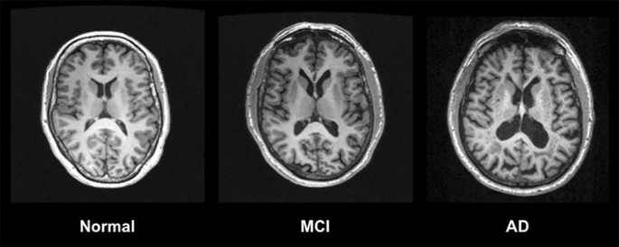
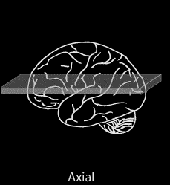
Imaging of the Brain
Front
Front
Notes:
Before getting to steps, let’s talk about the MRI images of brains. The images in our dataset are called axial cross-sections, which means you make cuts like this to see the internal structure of the brain.

Slide 15
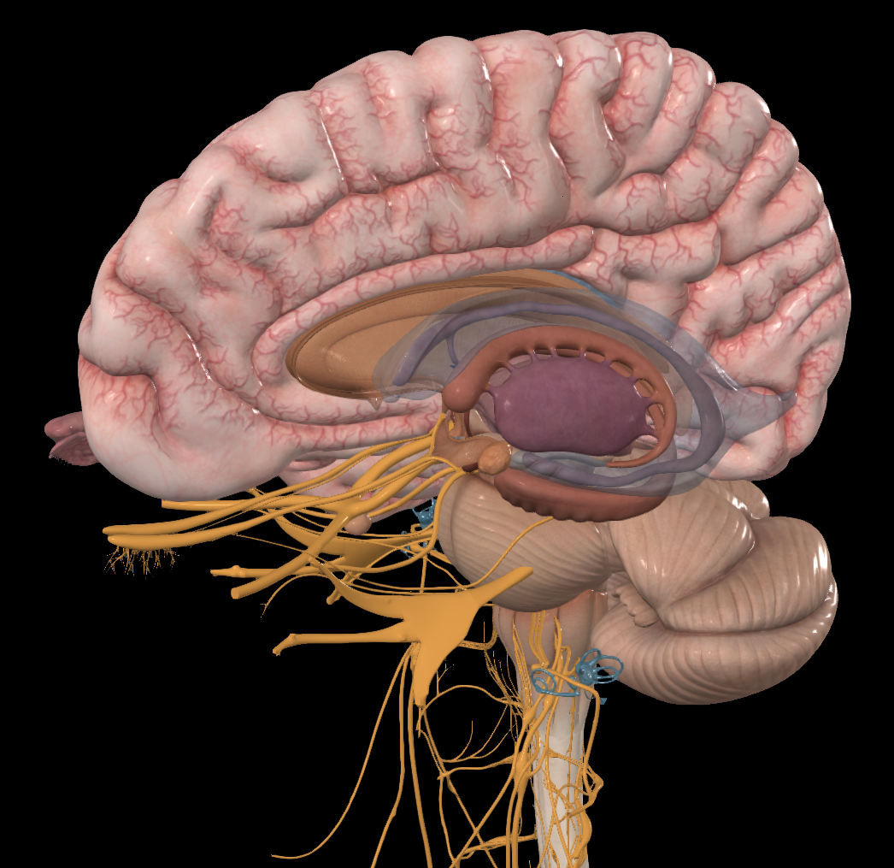
Morphological Changes in the Brain
Front
Sulci
Lateral Ventricle
Front
Hippocampus
Notes:
For people who have Alzheimer‘s, the shape of their brains changes. As more neurons die, many parts of the brain begin to shrink. This is called atrophy. The first part to suffer is the medial temporal lobe structures, such as the hippocampus, which plays an important role in learning and memory. As neurons die, the hippocampus gets smaller. And this is why people with Alzheimer‘s have a very short memory and have difficulties in learning new things.
█ There is a cavity inside the brain and it is depicted as a blue translucent part in the image to the left. That is called the lateral ventricle. It is a compartment filled with cerebrospinal fluid. As the hippocampus and other structures nearby shrink, this compartment becomes larger. So, in the MRI image, you will see an increased area of the lateral ventricle.
█ As time goes by, the toxic proteins will spread to all parts of the brain and kill neurons, causing the whole brain to shrink. At that time, the sulci, which are the grooves between folds, will be widened. Now, let’s look at an example.

Slide 16
Morphological Changes in the Brain
Front
Front
Notes:
For people who have Alzheimer‘s, the shape of their brains changes. As more neurons die, many parts of the brain begin to shrink. This is called atrophy. The first part to suffer is the medial temporal lobe structures, such as the hippocampus, which plays an important role in learning and memory. As neurons die, the hippocampus gets smaller. And this is why people with Alzheimer‘s have a very short memory and have difficulties in learning new things.
█ There is a cavity inside the brain and it is depicted as a blue translucent part in the image to the left. That is called the lateral ventricle. It is a compartment filled with cerebrospinal fluid. As the hippocampus and other structures nearby shrink, this compartment becomes larger. So, in the MRI image, you will see an increased area of the lateral ventricle.
█ As time goes by, the toxic proteins will spread to all parts of the brain and kill neurons, causing the whole brain to shrink. At that time, the sulci, which are the grooves between folds, will be widened. Now, let’s look at an example.

Slide 17
Morphological Changes in the Brain
Front
Front
Notes:
The image to the left is a normal brain. The one to the right has severe Alzheimer‘s. It’s clear to see that the ventricles in the one with Alzheimer’s are enlarged, and the sulci have been widened significantly. By using preprocessing, we hope we can make these structural changes more obvious and thus help improve the model’s accuracy.

Slide 18
Morphological Changes in the Brain
Front
Sulci
Lateral Ventricle
Front
Notes:
The image to the left is a normal brain. The one to the right has severe Alzheimer‘s. It’s clear to see that the ventricles in the one with Alzheimer’s are enlarged, and the sulci have been widened significantly. By using preprocessing, we hope we can make these structural changes more obvious and thus help improve the model’s accuracy.

Slide 19
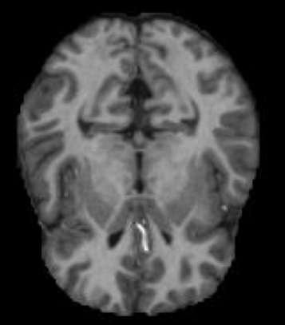
Preprocessing – Contrast Enhancement
Original Image
Notes:
The next step we took was contrast enhancement. This helps emphasize the differences between brain regions, making it easier for the model to detect atrophy and other disease-related changes.

Slide 20
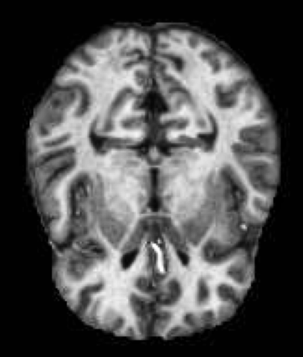
Preprocessing – Contrast Enhancement
Original Image
Contrast Adjustment
Notes:
The next step we took was contrast enhancement. This helps emphasize the differences between brain regions, making it easier for the model to detect atrophy and other disease-related changes.

Slide 21
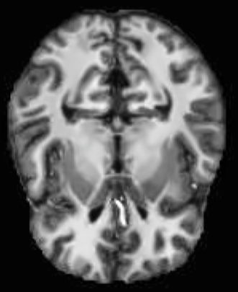
Preprocessing – Denoising
Original Image
Contrast Adjustment
Denoising
Notes:
Next, we applied denoising to the images to remove unwanted noise while preserving important details, which helps in the separation of brain fluids from white matter. This is important to identify the size of the ventricles.

Slide 22
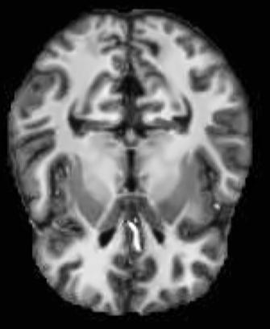
Preprocessing – Intensity Normalizing
Original Image
Contrast Adjustment
Denoising
Normalizing Intensity
Notes:
And finally, we normalize the intensity to ensure consistent intensity levels across images, enabling accurate feature extraction and comparison.

Slide 23
Data Augmentation
Training data: ​
Non-demented: 2560 cases​
Demented: 2561 cases
Test data:
Non-demented: 640 cases​
Demented: 639 cases
Purpose
Increase the amount of training data​
Improve model performance​
Reduce overfitting​
Augmented Data
Notes:
The dataset we have is actually not large. The training data set has around 5000 images. Data augmentation was used to increase the size and diversity of the dataset and the generalizability of the model, which improves model performance. We decided to generate 5000 augmented images.

Slide 24
Data Augmentation
Rotation: up to 15 degrees​
Horizontal shift: 5% of the width​
Vertical shift: 5% of the height​
Shear: 5%​
Zoom: 0.5%​
Horizontal flip​
Vertical flip
Notes:
The process of data augmentation is simple. We take a preprocessed image and make slight changes to it. We used seven augmentation techniques. Now, I will show you a fun little demo here. First, the image will be rotated up to 15 degrees.

Slide 25
Data Augmentation
Rotation: up to 15 degrees​
Horizontal shift: 5% of the width​
Vertical shift: 5% of the height​
Shear: 5%​
Zoom: 0.5%​
Horizontal flip​
Vertical flip
Notes:
Next, a random horizontal shift is introduced.

Slide 26
Data Augmentation
Rotation: up to 15 degrees​
Horizontal shift: 5% of the width​
Vertical shift: 5% of the height​
Shear: 5%​
Zoom: 0.5%​
Horizontal flip​
Vertical flip
Notes:
Similarly, a random vertical shift is applied.

Slide 27
Data Augmentation
Rotation: up to 15 degrees​
Horizontal shift: 5% of the width​
Vertical shift: 5% of the height​
Shear: 5%​
Zoom: 0.5%​
Horizontal flip​
Vertical flip
Notes:
Then, a random shear.

Slide 28
Data Augmentation
Rotation: up to 15 degrees​
Horizontal shift: 5% of the width​
Vertical shift: 5% of the height​
Shear: 5%​
Zoom: 0.5%​
Horizontal flip​
Vertical flip
Notes:
Followed by zooming up to 0.5%.

Slide 29
Data Augmentation
Rotation: up to 15 degrees​
Horizontal shift: 5% of the width​
Vertical shift: 5% of the height​
Shear: 5%​
Zoom: 0.5%​
Horizontal flip​
Vertical flip
Notes:
And finally, a random flip happens. It could be horizontal or vertical, or both.

Slide 30
Data Augmentation
Rotation: up to 15 degrees​
Horizontal shift: 5% of the width​
Vertical shift: 5% of the height​
Shear: 5%​
Zoom: 0.5%​
Horizontal flip​
Vertical flip
Notes:
In this case, it is a horizontal flip.

Slide 31
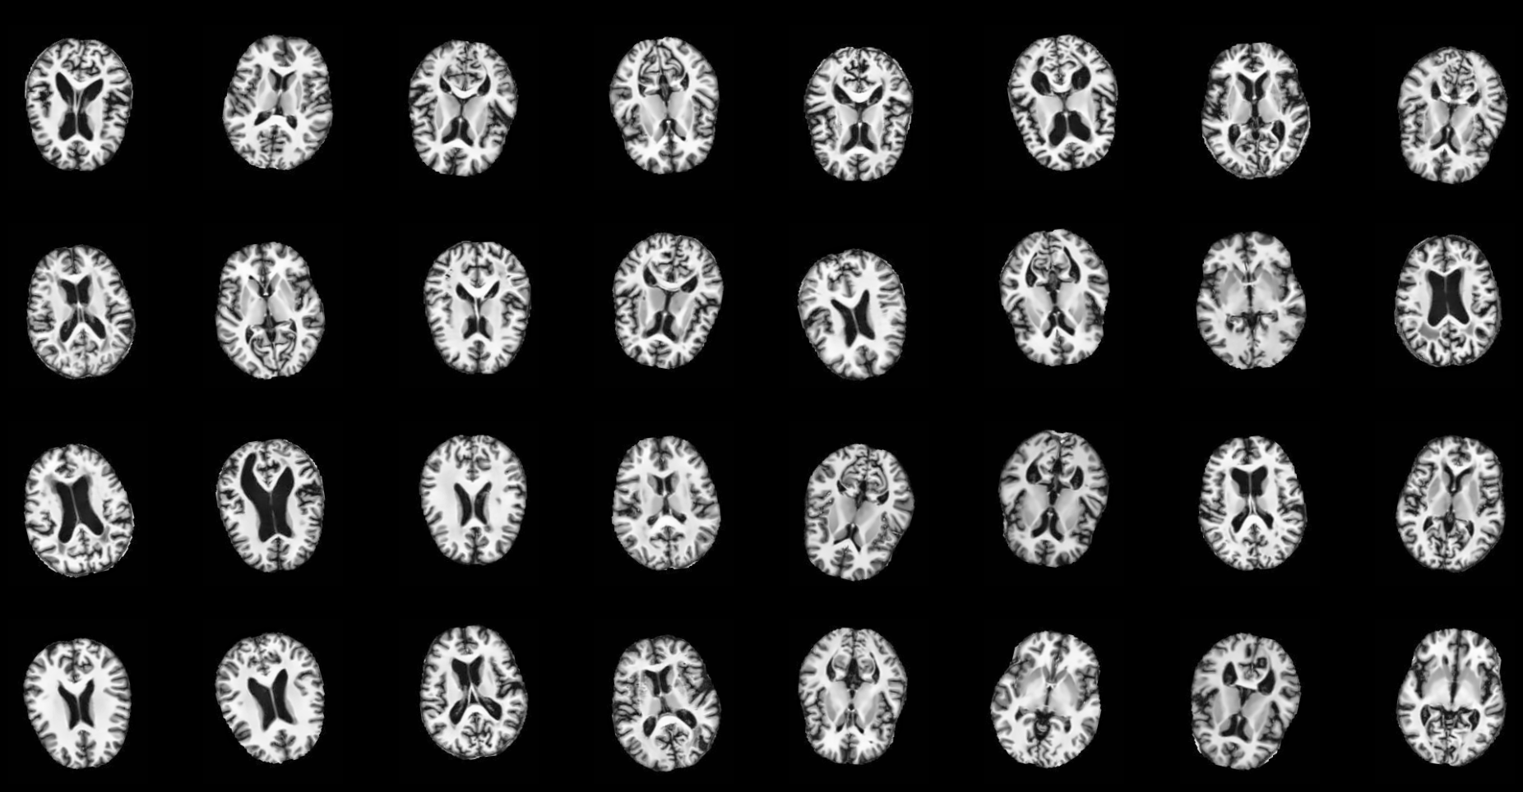
Data Augmentation
Notes:
And there you have it. 5000 augmented images ready to be fed into the model. Next, Zhenqi will talk about the actual model.

Slide 32
Transfer Learning and Model Selection – Issues with vanilla architecture
Input
Potential Limitation
Conv2D
Feature complexity:
Image data are complex and diverse
features within the image are difficult to be exhaustively recognized and extracted
Convolution Layers:
Extract features from image data
MaxPooling
BatchNormalization
Conv2D
Conv2D
MaxPooling
Increase the size of training data
Increased the number of convolution layers
Fully-connected Layers:
Use extracted features as inputs to learn the hidden patterns of the original image data
GlobalAveragePooling
Fully-connected
Computation burden:
Exploding RAM issue.
Long training time → delay the POC or tuning
Fully-connected
Output
Notes:
Thank you Jesse. Now we have the data ready, but there is one more thing we need to do before constructing our own model. In the traditional computer vision tasks using CNN, a typical architecture will look like this where you have the convolution layers and fully-connected layers. The convolution layers are used to extract features from image data while the fully-connected layers try to learn and model the hidden patterns beneath these features. Here, one limitation rises: What if the feature complexity is large in the original image data. Therefore, we might not have sufficient training images and convolution layers to fully identify and extract these features. We would partially solve the insufficient training data issue using data augmentation or just increase the size of training data and add more convolution layers. However, doing so will yield another more severe issue which is we might deplete our computational resources and thus unable to proceed with subsequent taks.

Slide 33
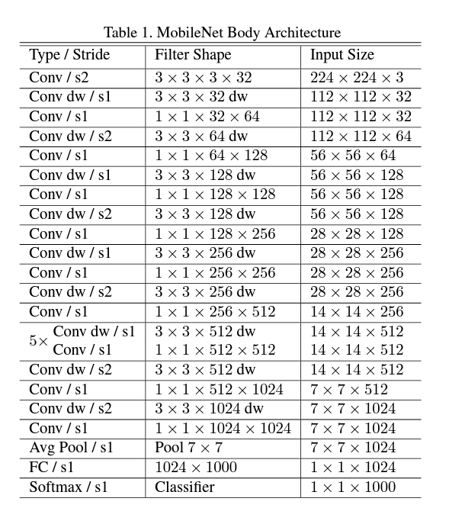
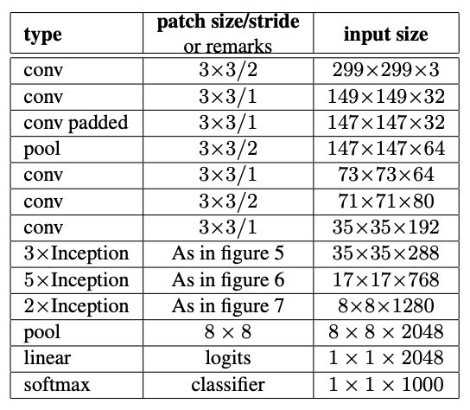

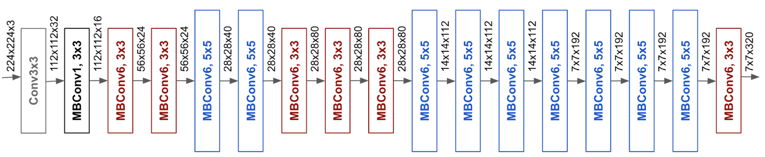
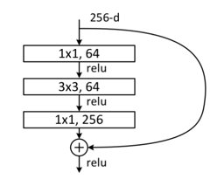
Transfer Learning and Model Selection – Leveraging pre-trained models
Popular pre-trained models used for image-related tasks in the medical industry
Popular pre-trained models used for image-related tasks in the medical industry
VGG
16 - 224x224
MobileNet
> 32x32
Inception:
V3 - 299x299
EfficientNet
B0 - 224x224
ResNet
50 - 224x224
Selection Criteria:
Input size
Performance
Selection Criteria:
Input size consideration
Performance driven
Notes:
This is where transfer learning comes in. In short, we effectively inherit the weights from these models with complex structures and were trained with a large amount of images, capable enough to extract all key features from image data. The candidate pre-trained models we selected were VGG, EfficientNet, ResNet, Inception, and MobileNet. During our research on the applications of CNN in the medical industry, we found these models to be prevalently used for image classification tasks and were having prominent performances. Now the question is, how do we select the one which is the best for us?
We chose model based on two criteria: First, the default input size which was initially used to train these models. Ideally, the closer the dimension the better so we can avoid overly up or downscale the image data. In that way, we can prevent the loss of key information within features. All these models have different versions and variations and we looked for those who had the closest dimension with our data. VGG16, ResNet50, EfficientNetB0 are all 224x224, Inception V3 is 299x299 and lastly, the MobileNet accept any size that are larger than 32x32. The final decision was based on their performance and naturally, we chose to go with the model which had the best performance on our task.

Slide 34
MobileNet:
Conv2D
3x3 Depthwise Conv
BatchNormalization
Relu
1x1 Conv
BatchNormalization
Trained layers and weights
Relu
3x3 Depthwise Conv
BatchNormalization
Relu
1x1 Conv
BatchNormalization
Relu
Fully-connected
Output
Notes:
The winner among them was MobileNet. On the right hand side, there is an overview of the general architecture of MobileNet and you haver these trained convolution layers and associated weights. So how to do we transfer these learned knowledge to our model?

Slide 35
MobileNet:
Conv2D
3x3 Depthwise Conv
BatchNormalization
Relu
1x1 Conv
BatchNormalization
Trained layers and weights
Relu
3x3 Depthwise Conv
BatchNormalization
Relu
1x1 Conv
BatchNormalization
Relu
Conv2D
Fully-connected
Replace with our customized layers
Output
Notes:
We will remove the original fully-connected layers and stack these convolution layers on top of our model. Note, the transferred convolution layers will be frozen meaning that their weights will not be updated during training. In this way, we can utilize the existing knowledge on shapes, corners, edges from the pre-trained model while not incurring additional computation burden.
Now we have the architecture with transfer learning ready. I will invite Sam to walk us through the next step, which is hyperparameter tuning.

Slide 36
Hyper-Parameter Tuning
Manual grid search due to computing power limitation
Test one parameter by keeping others as default, and choose the best performance factor
With the best-performing value, test other parameters
All combinations were tested and compared
Chose the model with the best performance (AUC score)
Hyperparameters | Search Space
Number of Filters in CNN layers | 16, 32, 64
Drop-out Rate | 0.3, 0.5, 0.6
CNN Filter Size | (3,3), (5,5)
Fully Connected Layer Size | 128, 256
Notes:
Thank you Zhenqi
After preprocessing, augmenting data, selecting pre-trained model, we now need to fine-tune the hyper parameters and see which model with which parameter value performs the best. We are building a CNN model, and we are mainly tuning four parameters: 1. number of filters in the CNN layers, 2. The CNN filter size, 3. the drop-out rate in the drop out layer, and 4. the number of neurons in the fully connected layers.
Due to the limited computing powers, we weren't able to perform tehcniques such as grid search, random search or Bayesian search. Our computers keep running out of RAM. So, instead of grid searching, we adopted an approach of parallerally testing each parameter combination. So, firstly, we set default values to all parameters, and then we test one parameter by keeping others as default. After we optimize this parameter, we keep it unchanged and testing the rest one by one, parallerally, on each of our computer. At the end, we have found the best performing model, in terms of the AUC score.
We used AUC score here because it represents the the overall performance of the classifier, regardless of the chose threshold value. It is a balanced criteria measuring how good our model performs.
By doing this, we adaptively choose the next search space, which is very efficient, but the limitation is very obvious. The initialization of the default value is very important. EVen though we have optimized every parameter, we cannot know if it is globally optimized, but this is the only way we could make it work due to capacity limitation.
Consider the limited computational resources, we have limited capacity to run a full-specturm parameter search. Therefore, we adapted our search strategies according to the situation, see below:
Paraellely fit the decided based architecture (decieded upon runing different scenarios on different models paraelly) on each model and choose the one with the best performance
Start with tuning for different number of conv layers and the size of FC layers, choose the combination which gave the best performance.
Based on the training and validation AUC socre, we found the issue of overfitting so we focused on apply regularization when tuning
Given the selected model, paraellely search for different dropout rate under different number of filters, choose the model with the best performance.
Core idea:
Adaptively choose the next search space based on the previous result. Advanatge is efficiency, limitation is similar to the initializtaion problem when doing step-wise model selection, although you may be choosing the parameters that are best given each step, you cannot be sure of the overall optimization.

Slide 37
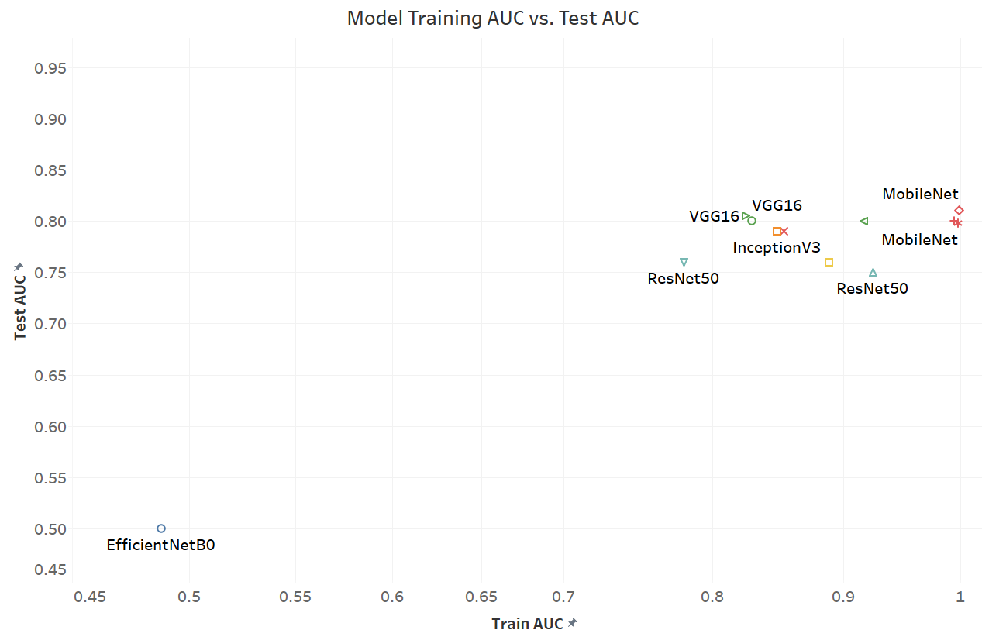
Tuning Results
Notes:
Here we have our tunning results, as you can see, EfficientNet performs the worst, while most others crod on the top right with high training and test AUC. The best performing model is MobileNet

Slide 38
Final Results & Conclusion
Pre-trained MobileNet Model
.
.
The Best Performing Model
Conv2D {Num Filter: 64, Num Param: 1,638,464, Filter: (3,3)}
Model Stats | Restuls
Total Params | 4,994,753
Frozen Params | 3,228,864
Trainable Params | 1,765,889
Train AUC Score | 0.99
Test AUC Score | 0.81
Final RECALL Score | 0.73
Dropout {Rate: 0.3}
Conv2D {Num Filter: 64, Num Param: 102,464, Filter: (3,3)}
Dropout {Rate: 0.3}
GloablAveragePooling2D
Full-connected {Num Neuron: 128, Param: 8320}
Dropout {Rate: 0.3}
A Recall of 0.73 makes the model a great pre-clinical trial examination tool for early AD detection.
Full-connected {Num Neuron: 128, Param: 16,512}
Dropout {Rate: 0.3}
Output
Notes:
So, the best performing model we tuned out is the MobileNet pre-trained model, with 64 filters per CNN layer, filter size (3,3), and 0.3 drop out rate. At the end, our model has total ~5 million parameters, with only 1.7M trainable. We achieved 99 training AUC and 0.81 test AUC.
When judging Alzhimers' disease, we do not want to let any potential patient go. Thus, we want to avoid false negative as much as we can, so RECALL can be a gooe measure for how good the model's probability of avoiding false negatives.
We have achieved a recall of 0.73. This is a fairly good result and makes our model a great pre-clinical trial examination tool for early Alzhimers detection

Slide 39
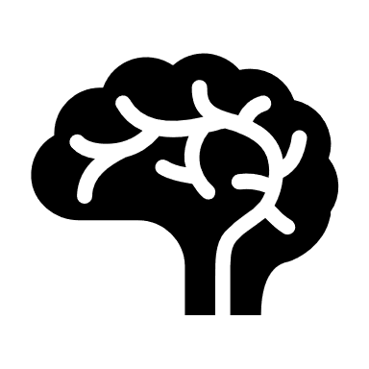
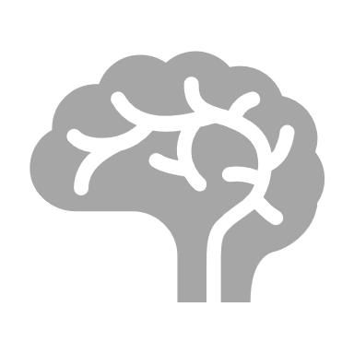

Applications
Original Scenario
Average time spend on MRI: 30 mins
Normal
AD
Total: 20 hours
Notes:
Now I will talk about the applications about our algorithm. Imagine a scenario like this, a radiologist have to look over 40 brain MRI scans everyday, and among all of them, 10 are from Alzheimer's Disease Patient. The radiologist will have to go over each MRI scan one by one manually. This is an extremely tiring job and the radiologist can only identify 6 of them but spend more than 8 hours.

Slide 40

Applications
New Scenario
Average time spend on MRI: 30 mins
Normal
AD
Demented: 40 minutes
Non-demented: 10 minutes
Total: 15.67 hours
Notes:
In contrast, under the same setup. If the algorithm is applied, radiologists can spend more time on demented patients hence, the radiologist is able to achieve a higher prediction accuracy. The diagnosis time also decreases as a result of better time allocation.

Slide 41
Value added By this Algorithm
Increase in accuracy
Distinguish between normal brain shrinkage and AD atrophy
Can discover patterns unrecognizable by human eyes
Aid radiologists in the diagnosis process
Increase in efficiency
Shorten time spend on non-demented cases
Reduce man power needed

Slide 42
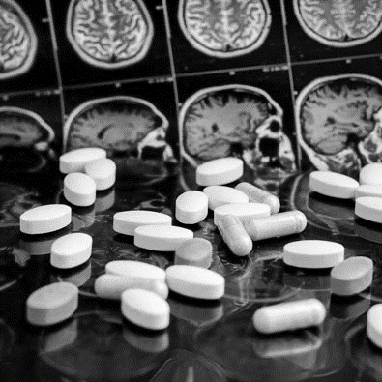
Back to Linda's Story
With a higher accuracy in the system, Linda is more likely to be diagnosed as an Alzheimer’s disease patient in her early 60s
She could have received intervention which would slow the progress of dementia

Slide 43
Limitations
Computational Insufficiency → suboptimal model
Not all possible hyperparameters were explored
Only explored a subset of image-classifying models
Not enough customized layers
Structural MRI
lacks molecular specificity. It cannot directly detect the histopathological hallmarks of AD
Can only detect Alzheimer's disease with structural changes

Slide 44
Future Works
Possible improvements

Slide 45
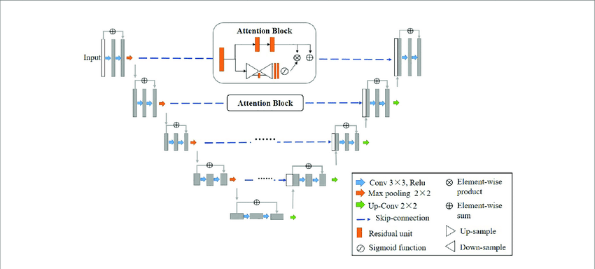
Medical Models & Customized Layers
Notes:
Firstly, we could try out more pre-trained models like U net and experiment with more self built fully connected layers

Slide 46
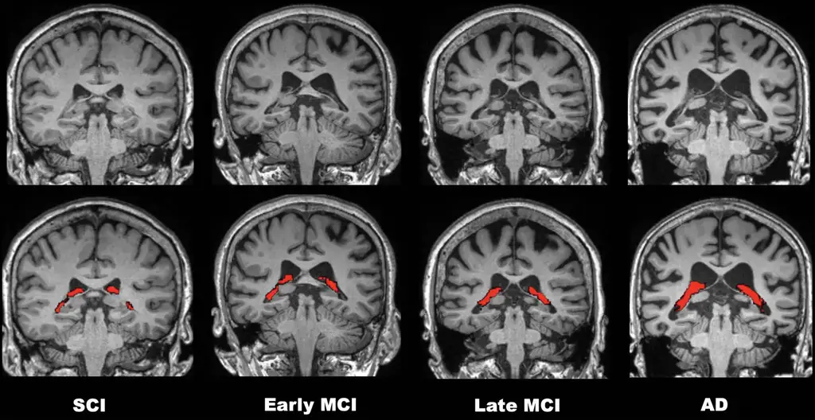
Keep Track of the Disease's Progression
Notes:
Secondly, we can improve the model to keep track of the structural change of the brain at different stages and call for intervention if needed.

Slide 47
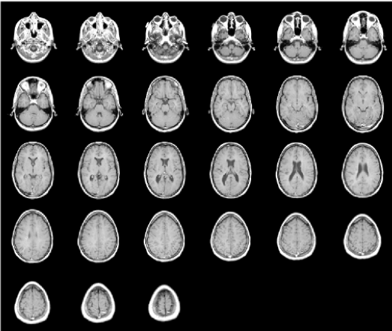
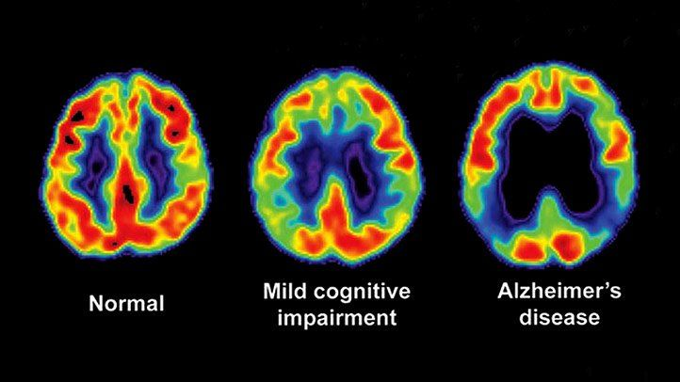
More Data
PET SCAN
3D MRI SCAN
Notes:
Thirdly, we could utilize more data by combining the PET SCAN which reports molecular specificity and 3D MRI SCAN that captures data from all layers. To increase model capacity.

Slide 48
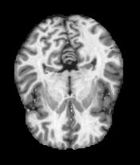
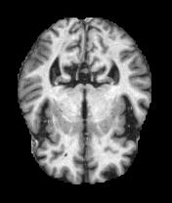
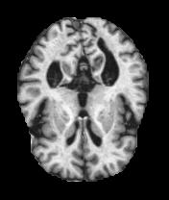
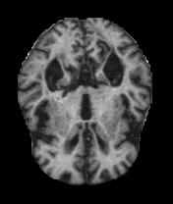
Multi-Classification Groups
No Risk
Low Risk
Medium Risk
High Risk
Notes:
Last but not least, we can switch the binary classification to multiclass classification once we have more data. This will enable us to set up an alarm system for early intervention.

Slide 49
Thanks

Slide 50
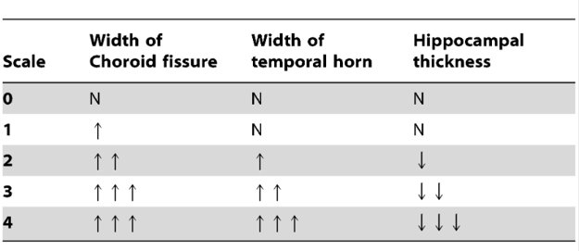
Rating Scales Used by Radiologists in Clinical Practice
Visual rating scales are often used by radiologists to assess the severity of atrophy
Scheltens scale for Medial Temporal Atrophy (MTA)
Koedam scale for Posterior Atrophy (PA)
Pasquier scale for Frontal Atrophy (FA)
AD leads to decreased hippocampal volume, shrinkage of the cerebral cortex, and ventricle enlargement.
MTA = 0: no atrophy in medial temporal lobe; MTA = 4: severe volume loss of hippocampus.
<75 years: ≥2 is abnormal
≥75 years: ≥3 is abnormal
Notes:
Some rating scales are used by radiologists to assess the severity of atrophy. We are taking MTA as example.
MTA measures the shrinkage of Medial Temporal Lobe. There are 4 stages of severity and as shown in red circles. MTA 0 means no atrophy. MTA 4 means severe hippocampus volumn loss and ventricle enlarged.

Slide 51
Transfer Learning and Model Selection – Issues with vanilla architecture
Input
Potential Limitation
Conv2D
Feature complexity:
Image data are complex and diverse, thus features within the image are often difficult to be exhaustively recognized and extracted
Convolution Layers:
Extract features from image data
MaxPooling
BatchNormalization
Conv2D
Conv2D
MaxPooling
Increase the size of training data
Increased the number of convolution layers
.
.
.
Fully-connected Layers:
Use extracted features as inputs to learn the hidden patterns of the original image data
GlobalAveragePooling
Fully-connected
Computation burden:
Running on retail hardwares often leads to exploding RAM issue. Even if hardware capacity allows for running, the training time is excessively long, which greatly delay the POC or tuning stage.
Fully-connected
.
.
Output
Notes:
Thank you Jesse. Now we have the data ready, but there is one more thing we need to do before constructing our own model. In the traditional computer vision tasks using CNN, a typical architecture will look like this where you have the convolution layers and fully-connected layers. The convolution layers are used to extract features from image data while the fully-connected layers try to learn and model the hidden patterns beneath these features. Here, one limitation rises: What if the feature complexity is large in the original image data. Therefore, we might not have sufficient training images and convolution layers to fully identify and extract these features. We would partially solve the insufficient training data issue using data augmentation or just increase the size of training data and add more convolution layers. However, doing so will yield another more severe issue which is we might deplete our computational resources and thus unable to proceed with subsequent taks.

Slide 52
MobileNet:
Conv2D
3x3 Depthwise Conv
BatchNormalization
Relu
1x1 Conv
BatchNormalization
Trained layers and weights
Relu
.
.
3x3 Depthwise Conv
BatchNormalization
Relu
1x1 Conv
BatchNormalization
Relu
.
.
Fully-connected
Output
Notes:
The winner among them was MobileNet. On the right hand side, there is an overview of the general architecture of MobileNet and you haver these trained convolution layers and associated weights. So how to do we transfer these learned knowledge to our model?

Slide 53
MobileNet:
Conv2D
3x3 Depthwise Conv
BatchNormalization
Relu
1x1 Conv
BatchNormalization
Trained layers and weights
Relu
.
.
3x3 Depthwise Conv
BatchNormalization
Relu
1x1 Conv
BatchNormalization
Relu
.
.
Replace with our customized layers
Conv2D
Fully-connected
Output
Notes:
We will remove the original fully-connected layers and stack these convolution layers on top of our model. Note, the transferred convolution layers will be frozen meaning that their weights will not be updated during training. In this way, we can utilize the existing knowledge on shapes, corners, edges from the pre-trained model while not incurring additional computation burden.
Now we have the architecture with transfer learning ready. I will invite Sam to walk us through the next step, which is hyperparameter tuning.

Slide 54
Hyper-Parameter Tuning
Due to limited computing powers, we weren't able to perform any search tuning technique.
Instead, we adopted an approach of parallerally testing all combinations
Test one parameter by keeping others as default, and choose the best performance factor
With the best performing value, test other factors parallerally.
All combinations were tested and comapred all models' performances
The model with the best performance (AUC score) was chosen
Number of Filters in CNN layers
CNN Filter Size
[ 16, 32, 64 ]
[ (3,3), (5,5) ]
Drop-out Rate
Fully Connected Layer Size
[ 0.3, 0.5, 0.6 ]
[ 128, 256 ]
Notes:
Thank you Zhenqi
After preprocessing, augmenting data, selecting pre-trained model, we now need to fine-tune the hyper parameters and see which model with which parameter value performs the best. We are building a CNN model, and we are mainly tuning four parameters: 1. number of filters in the CNN layers, 2. The CNN filter size, 3. the drop-out rate in the drop out layer, and 4. the number of neurons in the fully connected layers.
Due to the limited computing powers, we weren't able to perform tehcniques such as grid search, random search or Bayesian search. Our computers keep running out of RAM. So, instead of grid searching, we adopted an approach of parallerally testing each parameter combination. So, firstly, we set default values to all parameters, and then we test one parameter by keeping others as default. After we optimize this parameter, we keep it unchanged and testing the rest one by one, parallerally, on each of our computer. At the end, we have found the best performing model, in terms of the AUC score.
We used AUC score here because it represents the the overall performance of the classifier, regardless of the chose threshold value. It is a balanced criteria measuring how good our model performs.
By doing this, we adaptively choose the next search space, which is very efficient, but the limitation is very obvious. The initialization of the default value is very important. EVen though we have optimized every parameter, we cannot know if it is globally optimized, but this is the only way we could make it work due to capacity limitation.
Consider the limited computational resources, we have limited capacity to run a full-specturm parameter search. Therefore, we adapted our search strategies according to the situation, see below:
Paraellely fit the decided based architecture (decieded upon runing different scenarios on different models paraelly) on each model and choose the one with the best performance
Start with tuning for different number of conv layers and the size of FC layers, choose the combination which gave the best performance.
Based on the training and validation AUC socre, we found the issue of overfitting so we focused on apply regularization when tuning
Given the selected model, paraellely search for different dropout rate under different number of filters, choose the model with the best performance.
Core idea:
Adaptively choose the next search space based on the previous result. Advanatge is efficiency, limitation is similar to the initializtaion problem when doing step-wise model selection, although you may be choosing the parameters that are best given each step, you cannot be sure of the overall optimization.

Slide 55
Final Results & Conclusion
Pre-trained MobileNet Model
.
.
The Best Performing Model
Conv2D {Num Filter: 64, Num Param: 1,638,464, Filter: (3,3)}
Total Params: 4,994,753
Frozen Params: 3,228,864
Trainable Params: 1,765,889
Train AUC Score: 0.99
Test AUC Score: 0.81
Final RECALL Score: 0.73
Dropout {Rate: 0.3}
Conv2D {Num Filter: 64, Num Param: 102,464, Filter: (3,3)}
Dropout {Rate: 0.3}
GloablAveragePooling2D
Full-connected {Num Neuron: 128, Param: 8320}
Dropout {Rate: 0.3}
A Recall of 0.73 makes the model a great pre-clinical trial examination tool for early AD detection.
Full-connected {Num Neuron: 128, Param: 16,512}
Dropout {Rate: 0.3}
Output
Notes:
So, the best performing model we tuned out is the MobileNet pre-trained model, with 64 filters per CNN layer, filter size (3,3), and 0.3 drop out rate. At the end, our model has total ~5 million parameters, with only 1.7M trainable. We achieved 99 training AUC and 0.81 test AUC.
When judging Alzhimers' disease, we do not want to let any potential patient go. Thus, we want to avoid false negative as much as we can, so RECALL can be a gooe measure for how good the model's probability of avoiding false negatives.
We have achieved a recall of 0.73. This is a fairly good result and makes our model a great pre-clinical trial examination tool for early Alzhimers detection

Slide 56
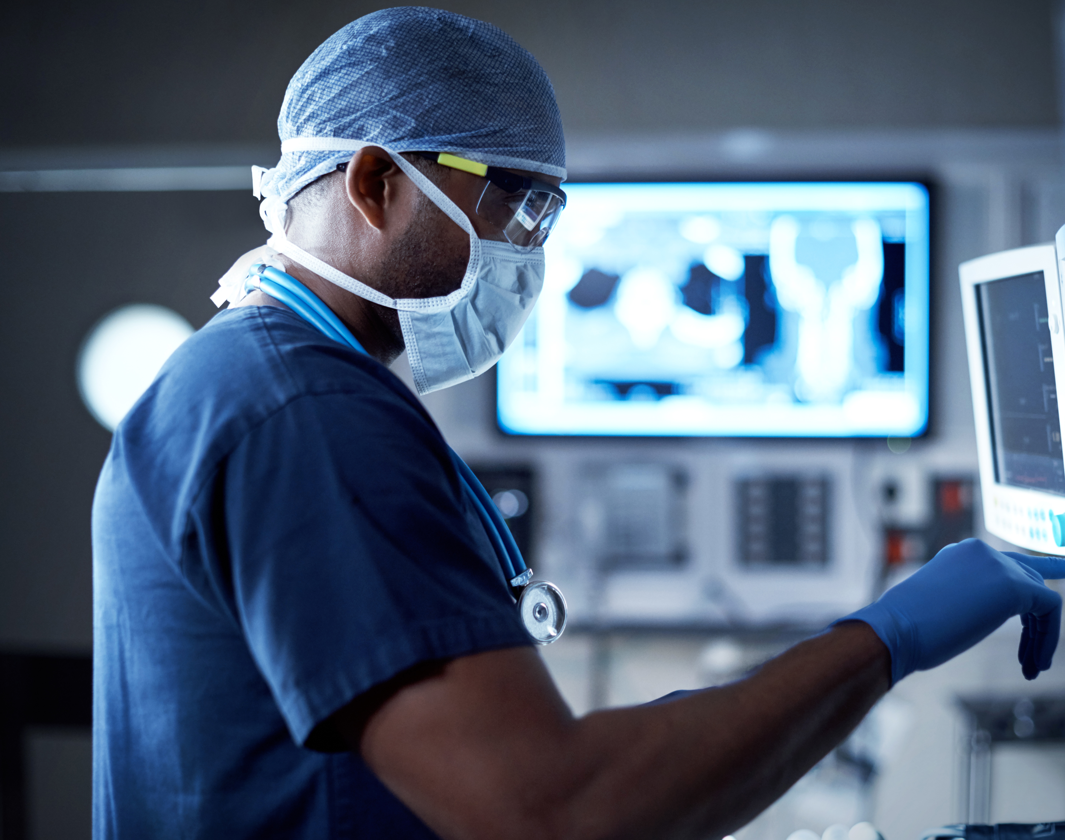
Applications
Notes:
Now I will talk about the applications about our algorithm.

Slide 57
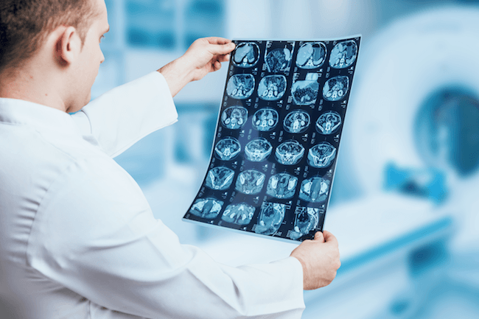
Original Scenario
Average time spend on MRI: 30 mins
40 Scans to be read
10 are from Alzheimer's Disease's patient
The radiologist must go through every segment of the brain MRI
Finally, be able to detect 6 of them
Achieves the average detection rate 60%
Spend in total of 20 hours
Notes:
Imagine a scenario like this, a radiologist have to look over 40 brain MRI scans everyday, and among all of them, 10 are from Alzheimer's Disease Patient. The radiologist will have to go over each MRI scan one by one manually. This is an extremely tiring job and the radiologist can only identify 6 of them but spend more than 8 hours.

Slide 58
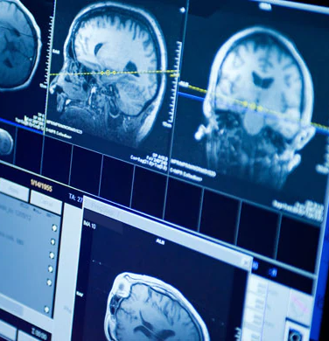
New Scenario
Same set up
The algorithm identify 18 of them as demented and 22 of them as non-demented
The radiologist can spend more time on demented scans(40 minutes for demented and 10 minutes for non-demented)
Finally, be able to detect 8 of them
Spend in total of 15.67 hours
Notes:
In contrast, under the same setup. If the algorithm is applied, radiologists can spend more time on demented patients hence, the radiologist is able to achieve a higher prediction accuracy. The diagnosis time also decreases as a result of better time allocation.

Slide 59
Value added By the Model
Increase in accuracy
The algorithm can tell the difference between Brain atrophy due to ageing and Brain atrophy brought on by tissue lesions
The algorithm can pick up pattern unrecognizable by human eyes
The Radiologist can focus more on demented cases
Increase in efficiency
Shorten time spend on non-demented cases
Allows for more tasks to be done by the radiologists.

Slide 60
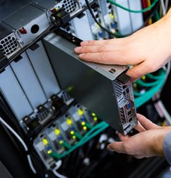
Limitations
Due to Computational Insufficiency-> suboptimal model
Didn't GridSearchCV all possible hyperparameters
Only tried a subset of image classifying model
Not enough customized layers
Structural MRI
lacks molecular specificity. It cannot directly detect the histopathological hallmarks of AD
In other words, it can only detect Alzheimer's disease caused by structural lesions

Slide 61
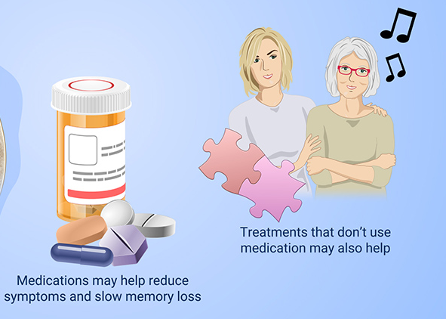
Back to Linda's Story
With a higher accuracy in the system, Linda is more likely to be diagnosed as an Alzheimer’s disease patient in her early 60s
She could have received intervention which would slow the progress of dementia

Slide 62
Medical Models & Customized Layers
Notes:
Firstly, we could try out more pre-trained models like U net and experiment with more self built fully connected layers

Slide 63
Keep Track of the Disease's Progression
Notes:
Secondly, we can improve the model to keep track of the structural change of the brain at different stages and call for intervention if needed.

Slide 64
More Data
PET SCAN
3D MRI SCAN
Notes:
Thirdly, we could utilize more data by combining the PET SCAN which reports molecular specificity and 3D MRI SCAN that captures data from all layers. To increase model capacity.

Slide 65
Multi-classification Groups
No risk
Low Risk
Medium Risk
High Risk
Notes:
Last but not least, we can switch the binary classification to multiclass classification once we have more data. This will enable us to set up an alarm system for early intervention.

